Slide 1

SOCIAL BOOKS
By
Awais Akbar
Karthick Pandi
Yang Wang

Slide 2
TECHNOLOGIES USED

Slide 3
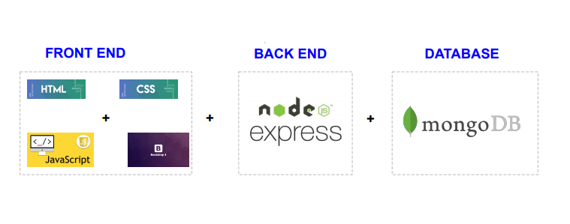

Slide 4

IDE

Slide 5
HOW THESE TECHNOLOGIES ARE COMING INTO PLAY ?
Front End page designing we used HTML and CSS.
Front End Framework we opt Bootstrap.
For implementing Functions we choose Javascript.

Slide 6
HOW THESE TECHNOLOGIES ARE COMING INTO PLAY ?
Back End is developed with the help of Node Js
For API creation we used Express a backend Framework.
And, Finally the Database is Mongo

Slide 7
ARCHITECURE DIAGRAM

Slide 8
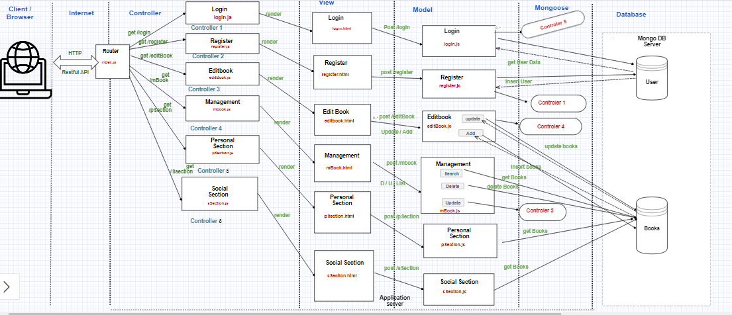

Slide 9
REQUIREMENTS
- User Sign In and Sign UP
- Adding the books to personal library by using
. Title
. Author
. Year
. ISBN
. Abstract
. Metadata

Slide 10
REQUIREMENTS
- Search based on Metedata tags
- Books Recommendation

Slide 11
LOGIN PAGE
Login Page has Two Main Functionalities :
1) Login
2) Register

Slide 12
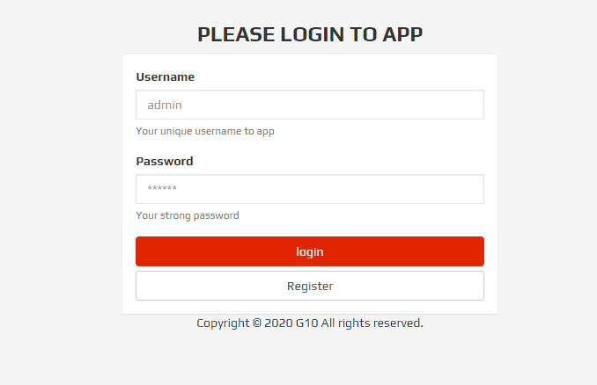
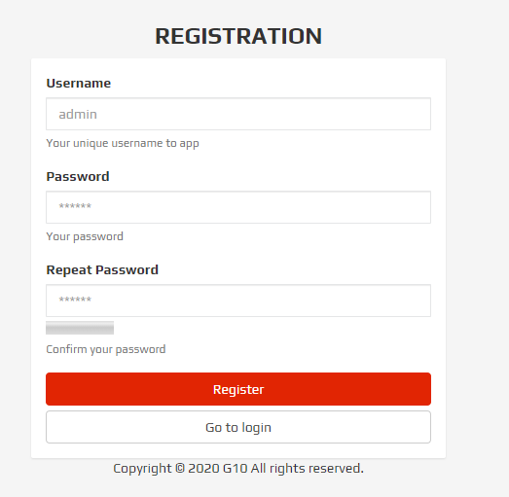
LOGIN PAGE

Slide 13
PERSONAL SECTION
Personal Section :
1) This section holds the list of books available in personal section
2) In addition to that it has customized search where we can able to search the books based on topics.

Slide 14
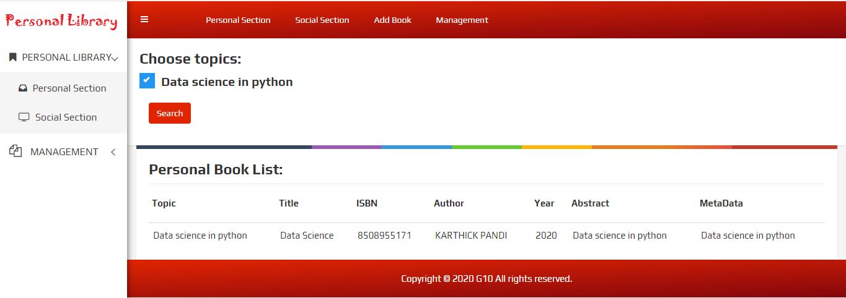
PERSONAL SECTION

Slide 15
SOCIAL SECTION
Social Section :
1) This section holds the list of books available in social section
2) In addition to that it has customized search where we can able to search the books based on topics.

Slide 16
SOCIAL SECTION
Social Section :
3) Book Recommendation:
User can able to view other user books if they share atleast three books in common.

Slide 17
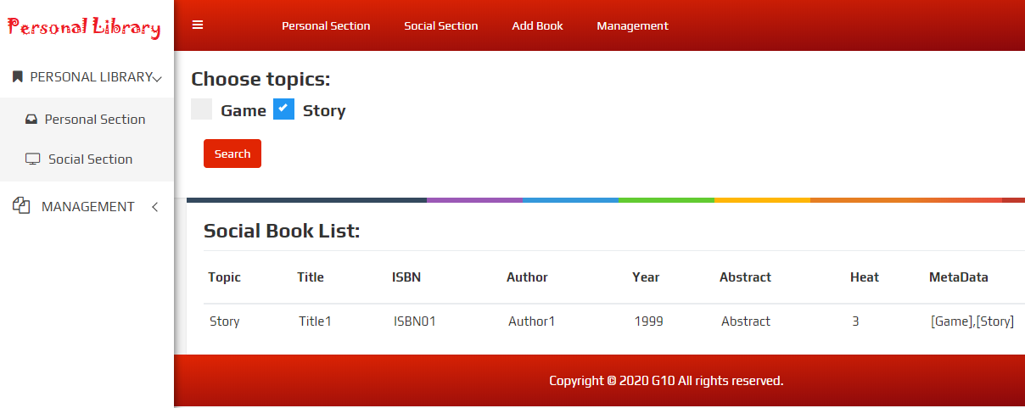
SOCIAL SECTION

Slide 18
ADD BOOK
Add Book :
1) Here we can add books to this library .The fields which required to add the books includes:
Title
Author
Public Year
ISBN
Abstract
Metadata

Slide 19
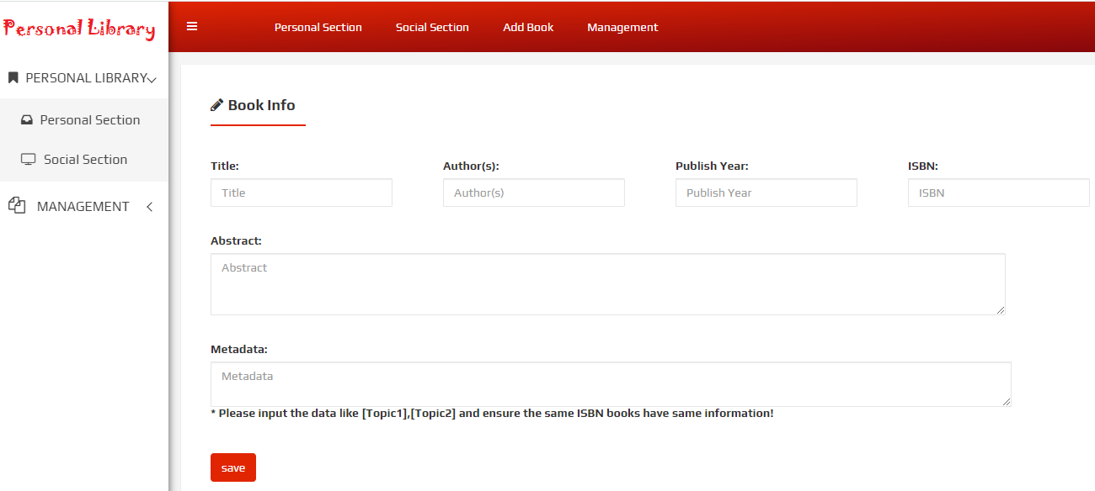
ADD BOOK

Slide 20
BOOK MANAGEMENT
Book Management :
1) Customized search based on Title,
Author Name, Published Year and ISBN

Slide 21
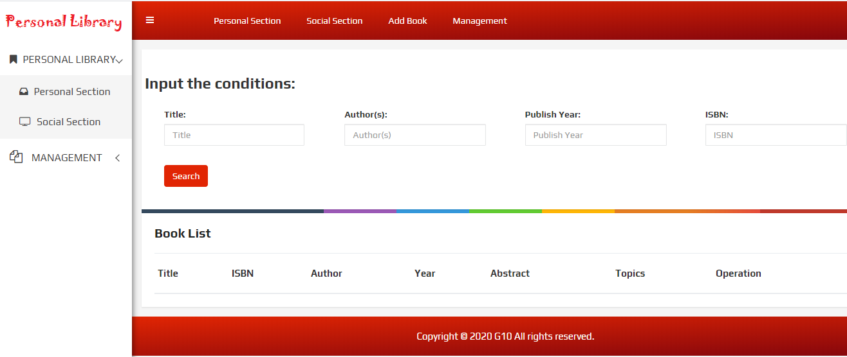
BOOK MANAGEMENT

Slide 22

WEB HOSTING

Slide 23
WHY AWS ?
Secure
Flexible
Reliable
Scalable
High Performance

Slide 24
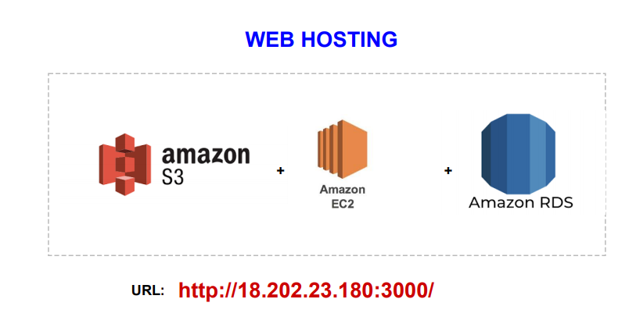
APP DEPLOYMENT

Slide 25
APP DEPLOYMENT
AMAZON S3 :
Storing the Files
EC2 :
Virtual Server
RDS :
Cloud Database

Slide 26
APP DEPLOYMENT
API : REST
PROTOCOL : HTTP

Slide 27


